Slide 1

Use Case Diagram

Slide 2
Introduction
Use-cases are descriptions of the functionality of a system from a user perspective.
  Depict the behaviour of the system, as it appears to an outside user.
  Describe the functionality and users (actors) of the system.
  Show the relationships between the actors that use the system, the use cases (functionality) they use, and the relationship between different use cases.
  Document the scope of the system.
  Illustrate the developer’s understanding of the user’s requirements.

Slide 3
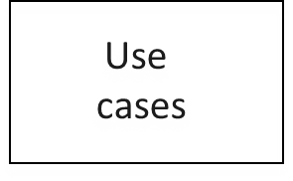
Use Case Diagram, purpose
Class
diagrams
Activity
diagrams
Requirements
document
(text in natural language)
Sequence
diagrams
Statechart
diagrams
Use case models are developed at different levels of abstraction
  system, system component, or a class.
Use case modelling is an iterative and incremental process.
  If user requirements change, the changes should be made in all the affected documents.

Slide 4
Use Case diagrams, basic UML notation
Use Case: A Use Case is a description of a set of interactions between a user and the system.
Components of use case diagram:
  Actor
  Use case
  System boundary
  Relationship
use case name
use case name
use case name

Slide 5
Use cases: Information captured
Actors
Relationships with other use cases
Pre-conditions
Details
Post-conditions
Exceptions
Constraints
Alternatives

Slide 6
ACTOR
An actor is some one or something that must interact with the system under development
Actors can be human or automated systems.
Actors are not part of the system.
UML notation for actor is stickman, shown below.
Student
Faculty
Employee

Slide 7
ACTOR (contd..)
It is role a user plays with respect to system.
Actors carry out use cases and a single actor may perform more than one use cases.
Actors are determined by observing the direct uses of the system

Slide 8
Primary and Secondary Actors
Primary Actor
  Acts on the system
  Initiates an interaction with the system
  Uses the system to fulfill his/her goal
  Events Something we don’t have control over
Secondary Actor
  Is acted on/invoked/used by the system
  Helps the system to fulfills its goal
  Something the system uses to get its job done

Slide 9
USE CASE
What is USE case?
A use case is a pattern of behavior, the system exhibits
The purpose of a use case is to define a piece of coherent behavior without revealing the internal structure of the system
The use cases are sequence of actions that the user takes on a system to get particular target
USE CASE is dialogue between an actor and the system.
Examples:
Add a course

Slide 10
Contd..
A use case typically represents a major piece of functionality that is complete from beginning to end.
Most of the use cases are generated in initial phase, but may add some more after proceeding.
A use case may be small or large. It captures a broad view of a primary functionality of the system in a manner that can be easily grasped by non technical user.

Slide 11
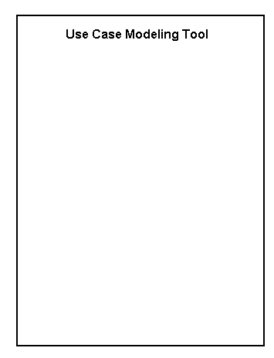
System Boundary
It is shown as a rectangle.
It helps to identify what is external versus internal, and what the responsibilities of the system are.
The external environment is represented only by actors.

Slide 12
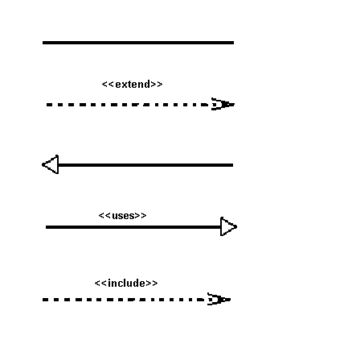
Relationship
Relationship is an association between use case and actor.
There are several Use Case relationships:
Association
Extend
Generalization
Uses
Include

Slide 13
Extend Relationship
The extended relationship is used to indicate that use case completely consists of the behavior of another use case at one or specific point
The insertion of additional behavior into a base use case that does not know about it
The base use case implicitly incorporates the behavior of another use case at certain points called extension points
It is shown as a dotted line with an arrow point and labeled <<extend>>
Login
<< extend>>
Register New User

Slide 14
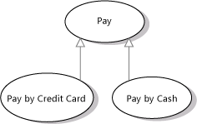
Generalization
Generalization is a relationship between a general use case and a more specific use case that inherits and extends features to it
use cases that are specialized versions of other use cases
It is shown as a solid line with a hollow arrow point

Slide 15

Include Relationship
The insertion of additional behavior into a base use case that explicitly describes the insertion
The base use case explicitly incorporates the behavior of another use case at a location specified in the base.
They are shown as a dotted line with an open arrow and the key word <<include>>

Slide 16
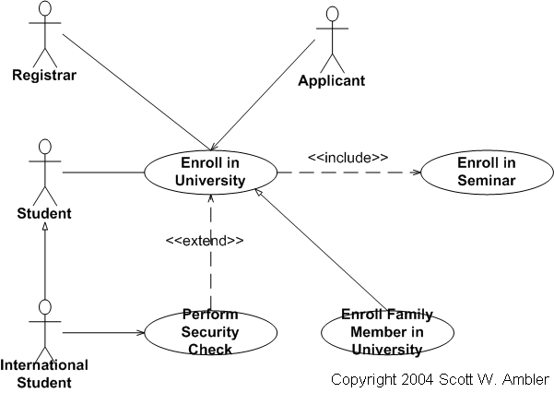
Extend vs Include

Slide 17
Example
place
conference call
place
phone call
<<extend>>
cellular
network
receive
additional call
receive
phone call
<<extend>>
use
scheduler
user
Cellular Telephone

Slide 18
Use Cases Describe Function not Form
Use Cases describe WHAT the system should do, but never HOW it will be done
Use cases are Analysis products, not design products

Slide 19
Use Case Description
Each use case may include all or part of the following:
  Title or Reference Name - meaningful name of the UC
  Author/Date - the author and creation date
  Modification/Date - last modification and its date
  Purpose - specifies the goal to be achieved
  Overview - short description of the processes
  Cross References - requirements references
  Actors - agents participating
  Pre Conditions - must be true to allow execution
  Post Conditions - will be set when completes normally
  Normal flow of events - regular flow of activities
  Alternative flow of events - other flow of activities
  Exceptional flow of events - unusual situations
  Implementation issues - foreseen implementation problems

Slide 20
Example- Money Withdraw
Use Case: Withdraw Money
Author: PKD
Date: 11-09-2013
Purpose: To withdraw some cash from user’s bank account
Overview: The use case starts when the customer inserts his card into the system. The system requests the user PIN. The system validates the PIN. If the validation succeeded, the customer can choose the withdraw operation else alternative 1 – validation failure is executed. The customer enters the amount of cash to withdraw. The system checks the amount of cash in the user account, its credit limit. If the withdraw amount in the range between the current amount + credit limit the system dispense the cash and prints a withdraw receipt, else alternative 2 – amount exceeded is executed.
Cross References: R1.1, R1.2, R7

Slide 21
Actors: Customer
Pre Condition:
  The ATM must be in a state ready to accept transactions
  The ATM must have at least some cash on hand that it can dispense
  The ATM must have enough paper to print a receipt for at least one transaction
Post Condition:
  The current amount of cash in the user account is the amount before the withdraw minus the withdraw amount
  A receipt was printed on the withdraw amount
  The withdraw transaction was audit in the System log file

Slide 22
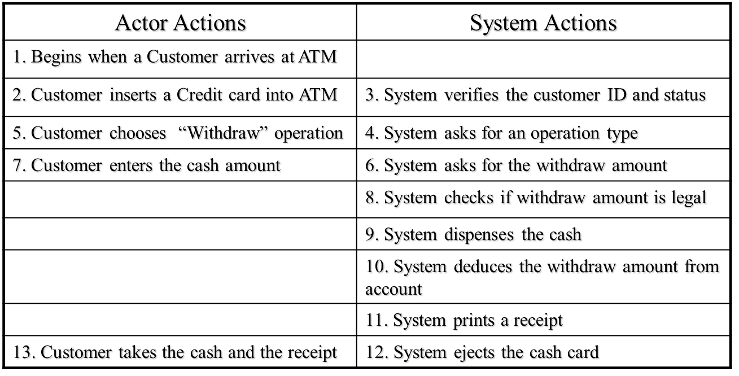
Typical course of events

Slide 23
Alternative flow of events:
  Step 3: Customer authorization failed. Display an error message, cancel the transaction and eject the card.
  Step 8: Customer has insufficient funds in its account. Display an error message, and go to step 6.
  Step 8: Customer exceeds its legal amount. Display an error message, and go to step 6.
Exceptional flow of events:
  Power failure in the process of the transaction before step 9, cancel the transaction and eject the card

Slide 24
One method to identify use cases is actor-based:
  - Identify the actors related to a system or organization.
  - For each actor, identify the processes they initiate or participate in.
A second method to identify use cases is event-based:
- Identify the external events that a system must respond to.
- Relate the events to actors and use cases.
The following questions may be used to help identify the use cases for a system:
  What are tasks of each actor ?
  Will any actor create, store, change, remove, or read information in the system ?
  What use cases will create, store, change, remove, or read this information ?
  Will any actor need to inform the system about sudden, external changes ?
  Does any actor need to be informed about certain occurrences in the system ?
  Can all functional requirements be performed by the use cases ?

Slide 25
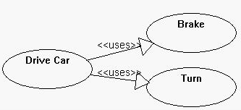
Uses Relationship
When a use case uses another process, the relationship can be shown with the uses relationship
This is shown as a solid line with a hollow arrow point and the <<uses>> keyword

